Slide 1
ME609
OPTIMIZATION METHODS IN ENGINEERING
PROJECT PHASE I
GROUP NO. 20
Kathir Ilakkiyan S M 200103125
Nameet 200104065

Slide 2
INTRODUCTION
Bracketing method : Bounding Phase method
In Bounding Phase method, we start with an initial guess of the optimum value. The lower and the upper bound for the interval is user defined for given function. Based on comparing the function values, the interval is narrowed around the minimum or the maximum. The process is continuously iterated until the required optimum is within the narrowed bounds. As the interval is very compact, this can be used to exactly find the optimal value by employing more precise optimization techniques like the secant method.
Secant method
It’s a gradient based search method used to minimize or maximize a function. Two initial points are selected which contains the optimal value in their interval.
z = x1 - (f’(x1) * (x1 - x0)) / (f’(x1) - f’(x0)) is used to find the optimum. For each iteration, x0 is updated as x1 and x1 is updated as z. Until required accuracy is acquired, the process is iterated. The final z value gives the optimal value.

Slide 3

Bounding phase method Iterations
Secant method Iterations, Epsilon = 0.001
Iter | Delta | x0 | x1 | f(x0) | f(x1) | a | b
1 | -0.1200 | -5.001 | -5.121 | 36810.716 | 37921.917 | -5.121 | -5.001
2 | -0.1200 | -5.121 | -5.361 | 37921.917 | 39751.705 | -5.361 | -5.121
3 | -0.1200 | -5.361 | -5.841 | 39751.705 | 41123.316 | -5.841 | -5.361
Iter | x0 | x1 | z | f_dash(x0) | f_dash(x1)
1 | -5.841 | -5.361 | -5.759 | -1297.576 | 6336.861
2 | -5.361 | -5.759 | -5.779 | 6336.861 | 295.321
3 | -5.759 | -5.779 | -5.775 | 295.321 | -73.003
4 | -5.779 | -5.775 | -5.775 | -73.003 | 0.587
5 | -5.775 | -5.775 | -5.775 | 0.587 | 0.001

Slide 4
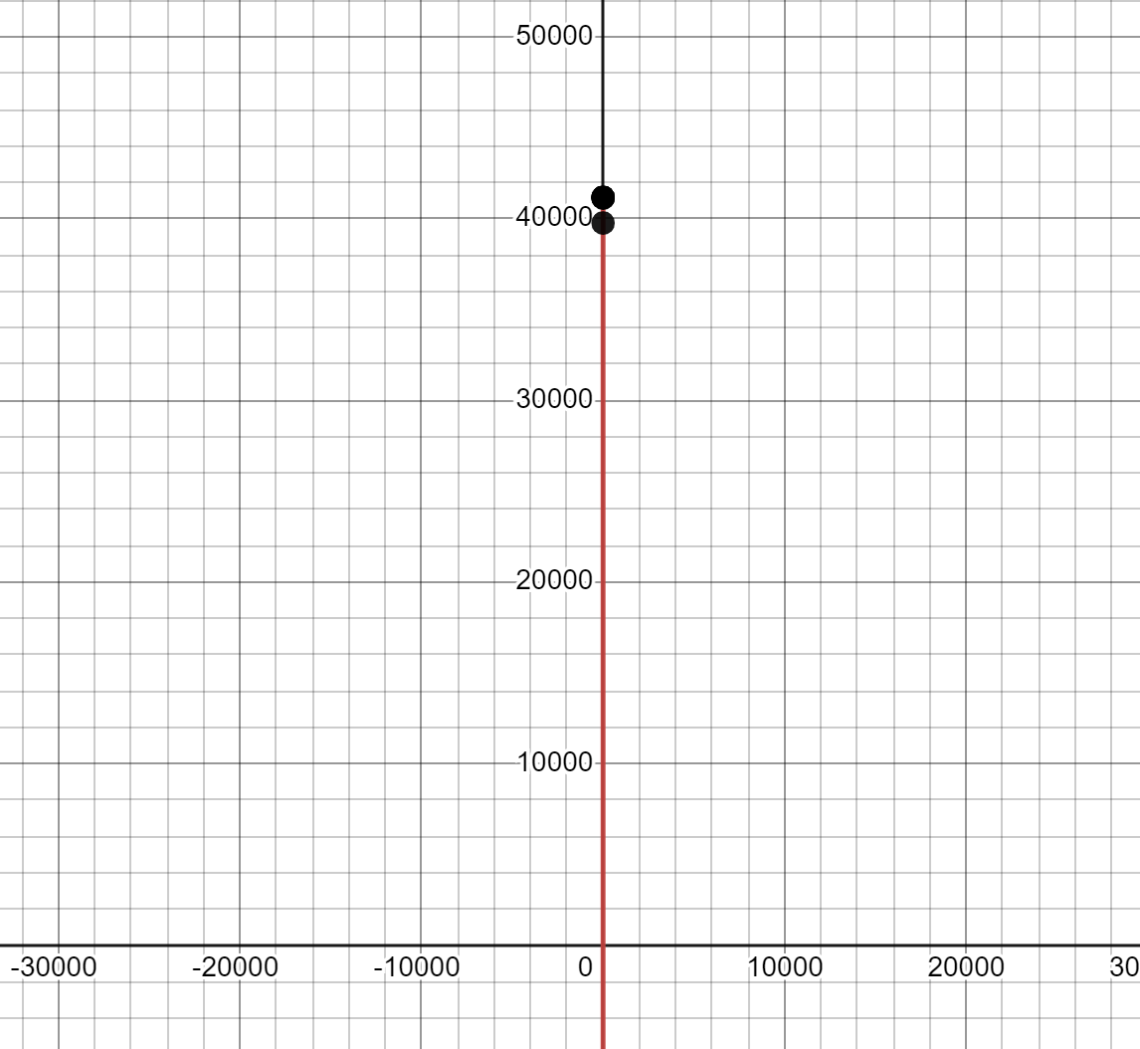
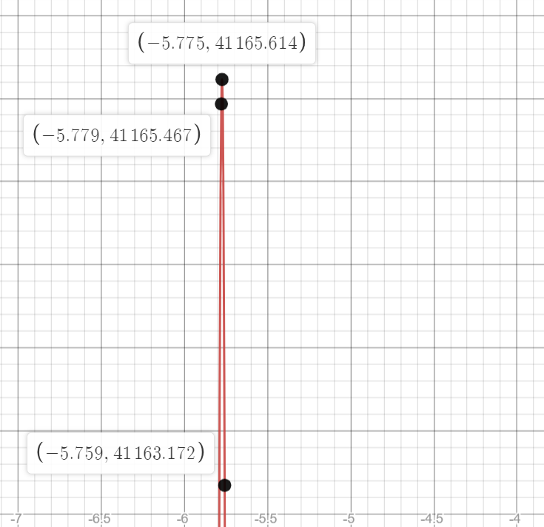

Slide 5
Initial Interval: (-10,0)
 | Bounding Phase Method |  |  |  | Secant Method
S.no. | Initial guess | delta | Interval | Iters | Epsilon | Max Iters | Max x | Max val | Iters
1 | -5 | 0.12 | (-5.84,-5.36) | 3 | 0.001 | 100 | -5.775064 | 41165.614407 | 5
2 | -4 | 0.1 | (-7.10,-5.50) | 5 | 0.0001 | 100 | -5.775024 | 41165.614389 | 6
3 | -3 | 0.05 | (-6.15,-4.55) | 6 | 0.0005 | 100 | -5.775023 | 41165.614388 | 7
4 | -6 | 0.01 | (-5.85,-5.69) | 5 | 0.0002 | 100 | -5.775067 | 41165.614407 | 4
5 | -5.9 | 0.02 | (-5.84,-5.76) | 3 | 0.002 | 100 | -5.775071 | 41165.614407 | 3
6 | -4.5 | 0.15 | (-6.75,-5.55) | 4 | 0.0004 | 100 | -5.775043 | 41165.614401 | 6
7 | –3.5 | 0.001 | (-7.595,5.547) | 12 | 0.00001 | 100 | -5.774996 | 41165.614358 | 7
8 | -5.1 | 0.09 | (-6.45,-5.73) | 4 | 0.00005 | 100 | -5.775059 | 41165.614406 | 5
9 | -6.25 | 0.005 | (-5.935,-5.615) | 7 | 0.0006 | 100 | -5.775066 | 41165.614407 | 5
10 | -5.25 | 0.008 | (-6.266,-5.754) | 7 | 0.0004 | 100 | -5.775063 | 41165.614407 | 4

Slide 6

Bounding phase method Iterations
Secant method Iterations, Epsilon = 0.001
Iter | Delta | x0 | x1 | f(x0) | f(x1) | a | b
1 | 0.0100 | -1.245 | -1.235 | 7.984 | 8.005 | -1.245 | -1.235
2 | 0.0100 | -1.235 | -1.215 | 8.005 | 8.043 | -1.235 | -1.215
3 | 0.0100 | -1.215 | -1.175 | 8.043 | 8.110 | -1.215 | -1.175
4 | 0.0100 | -1.175 | -1.095 | 8.110 | 8.208 | -1.175 | -1.095
5 | 0.0100 | -1.095 | -0.935 | 8.208 | 8.267 | -1.095 | -0.935
Iter | x0 | x1 | z | f_dash(x0) | f_dash(x1)
1 | -1.095 | -0.935 | -0.959 | -0.928 | 0.162
2 | -0.935 | -0.959 | -0.960 | 0.162 | 0.009
3 | -0.959 | -0.960 | -0.960 | 0.009 | -0.000
4 | -0.960 | -0.960 | -0.960 | -0.000 | 0.000

Slide 7
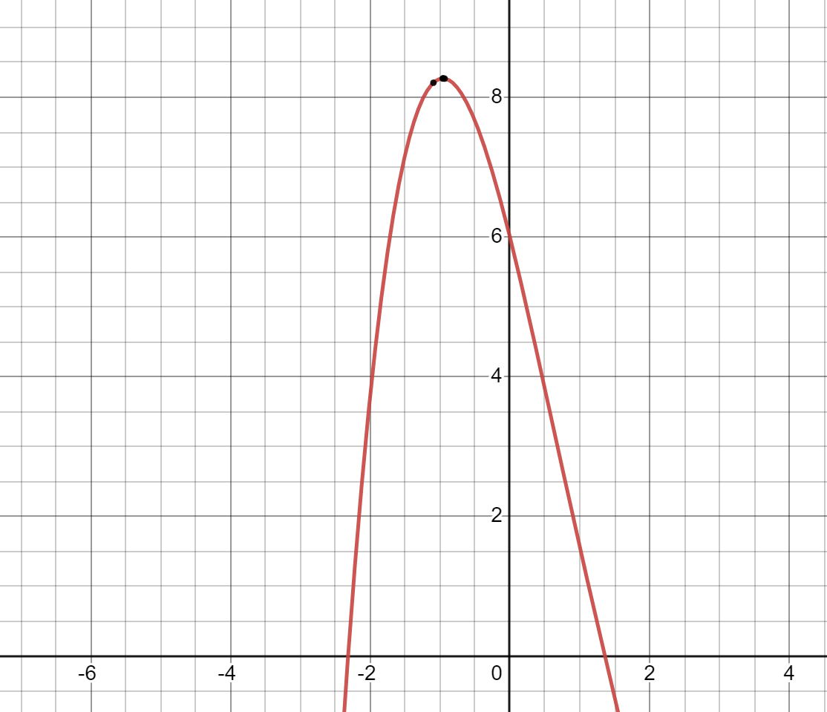
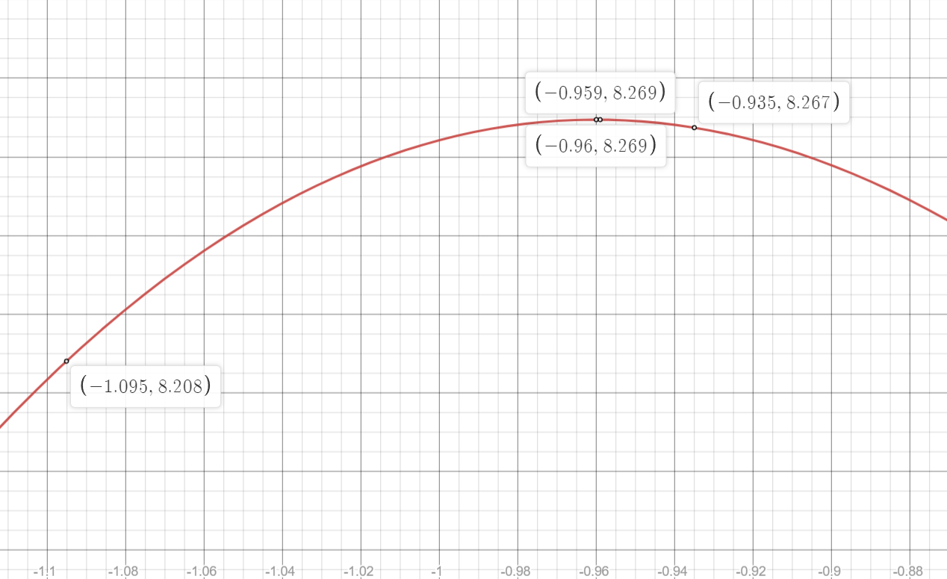

Slide 8
Initial Interval:(-2,1)
 | Bounding Phase Method |  |  |  | Secant Method
S.no. | Initial guess | delta | Interval | Iters | Epsilon | Max Iters | Max x | Max val | Iters
1 | 0.5 | 0.12 | (-1.3,-0.34) | 4 | 0.001 | 100 | -0.960139 | 8.269478 | 6
2 | -0.5 | 0.1 | (-1.2,-0.8) | 3 | 0.0001 | 100 | -0.960149 | 8.269478 | 5
3 | 0.0005 | 0.05 | (-1.5495,-0.7495) | 5 | 0.0005 | 100 | -0.960142 | 8.269478 | 5
4 | 0.01 | 0.01 | (-1.26,-0.62) | 7 | 0.0002 | 100 | -0.960145 | 8.269478 | 5
5 | -1 | 0.02 | (-0.98,-0.94) | 2 | 0.002 | 100 | -0.960152 | 8.269478 | 3
6 | -1.5 | 0.15 | (-1.05,-0.45) | 3 | 0.0004 | 100 | -0.960146 | 8.269478 | 5
7 | 0 | 0.001 | (-1.023,-0.511) | 10 | 0.00001 | 100 | -0.960148 | 8.269478 | 6
8 | 0.1 | 0.09 | (-1.25,-0.53) | 4 | 0.00005 | 100 | -0.960144 | 8.269478 | 4
9 | -1.1 | 0.005 | (-1.025,-0.945) | 5 | 0.0006 | 100 | -0.960153 | 8.269478 | 3
10 | -0.6 | 0.008 | (-1.104,-0.848) | 6 | 0.0004 | 100 | -0.960149 | 8.269478 | 4

Slide 9

Bounding phase method Iterations
Secant method Iterations, Epsilon = 0.001
Iter | Delta | x0 | x1 | f(x0) | f(x1) | a | b
1 | 0.1000 | 0.645 | 0.745 | 1.551 | 2.020 | 0.645 | 0.745
2 | 0.1000 | 0.745 | 0.945 | 2.020 | 3.064 | 0.745 | 0.945
3 | 0.1000 | 0.945 | 1.345 | 3.064 | 5.243 | 0.945 | 1.345
4 | 0.1000 | 1.345 | 2.145 | 5.243 | 7.204 | 1.345 | 2.145
Iter | x0 | x1 | z | f_dash(x0) | f_dash(x1)
1 | 1.345 | 2.145 | 1.982 | -5.103 | 1.302
2 | 2.145 | 1.982 | 2.027 | 1.302 | -0.494
3 | 1.982 | 2.027 | 2.029 | -0.494 | -0.018
4 | 2.027 | 2.029 | 2.029 | -0.018 | 0.000
5 | 2.029 | 2.029 | 2.029 | 0.000 | -0.000

Slide 10
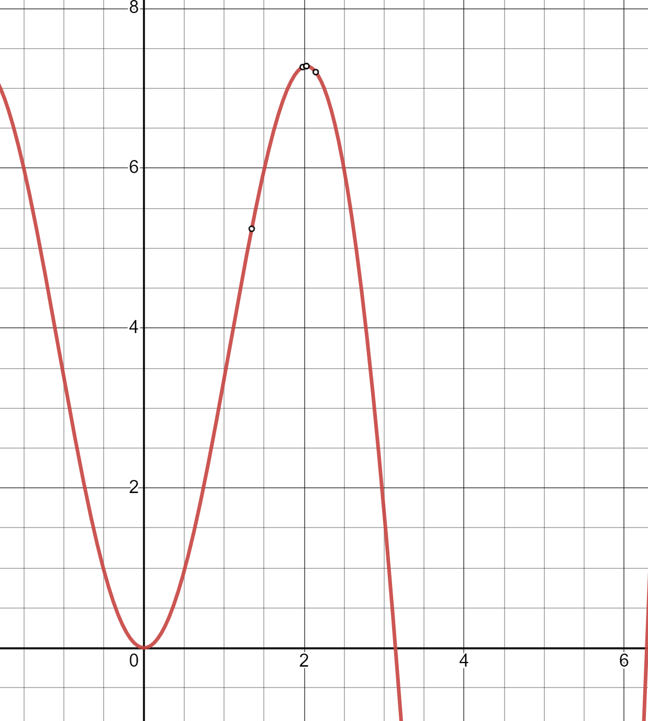
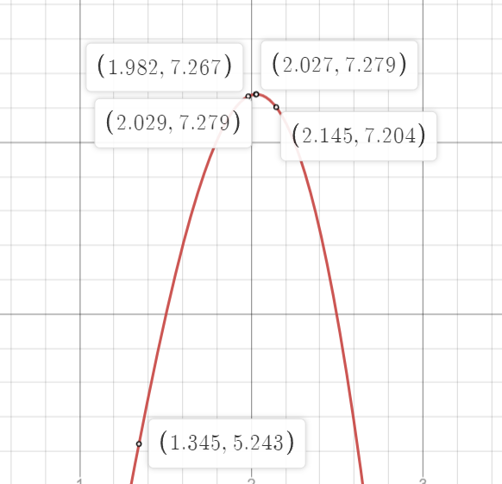

Slide 11
Initial Interval: (0.5,π)
 | Bounding Phase Method |  |  |  | Secant Method
S.no. | Initial guess | delta | Interval | Iters | Epsilon | Max Iters | Max x | Max val | Iters
1 | 1.5 | 0.12 | (1.860,2.340) | 3 | 0.001 | 100 | 2.028755 | 7.278823 | 5
2 | 3 | 0.1 | (1.50,2.30) | 4 | 0.0001 | 100 | 2.028751 | 7.278823 | 5
3 | 2.5 | 0.05 | (2.750,2.15) | 4 | 0.0005 | 100 | 2.028758 | 7.278823 | 4
4 | 0.8 | 0.01 | (1.43,2.07) | 7 | 0.0002 | 100 | 2.028754 | 7.278823 | 4
5 | 1 | 0.02 | (1.62,2.26) | 6 | 0.002 | 100 | 2.028753 | 7.278823 | 5
6 | 2 | 0.15 | (0.50,π) | 0 | 0.0004 | 100 | 2.028681 | 7.278823 | 8
7 | 0.52 | 0.001 | (1.543,2.567) | 11 | 0.00001 | 100 | 2.028746 | 7.278823 | 6
8 | 1.47 | 0.09 | (1.74,2.10) | 3 | 0.00005 | 100 | 2.028756 | 7.278823 | 5
9 | 1.3 | 0.005 | (1.935,2.575) | 8 | 0.0006 | 100 | 2.028753 | 7.278823 | 5
10 | 1.95 | 0.008 | (2.006,2.070) | 4 | 0.0004 | 100 | 2.028754 | 7.278823 | 3

Slide 12

Bounding phase method Iterations
Secant method Iterations, Epsilon = 0.001
Iter | Delta | x0 | x1 | f(x0) | f(x1) | a | b
1 | 0.1200 | 0.864 | 0.984 | 10.577 | 9.029 | 0.864 | 0.984
2 | 0.1200 | 0.984 | 1.224 | 9.751 | 7.639 | 0.984 | 1.224
3 | 0.1200 | 1.224 | 1.704 | 8.423 | 12.190 | 1.224 | 1.704
Iter | x0 | x1 | z | f_dash(x0) | f_dash(x1)
1 | 1.224 | 1.704 | 1.552 | 4.515 | -2.094
2 | 1.704 | 1.552 | 1.587 | -2.094 | 0.618
3 | 1.552 | 1.587 | 1.591 | 0.618 | 0.068
4 | 1.587 | 1.591 | 1.591 | 0.068 | -0.003
5 | 1.591 | 1.591 | 1.591 | -0.003 | 0.000

Slide 13
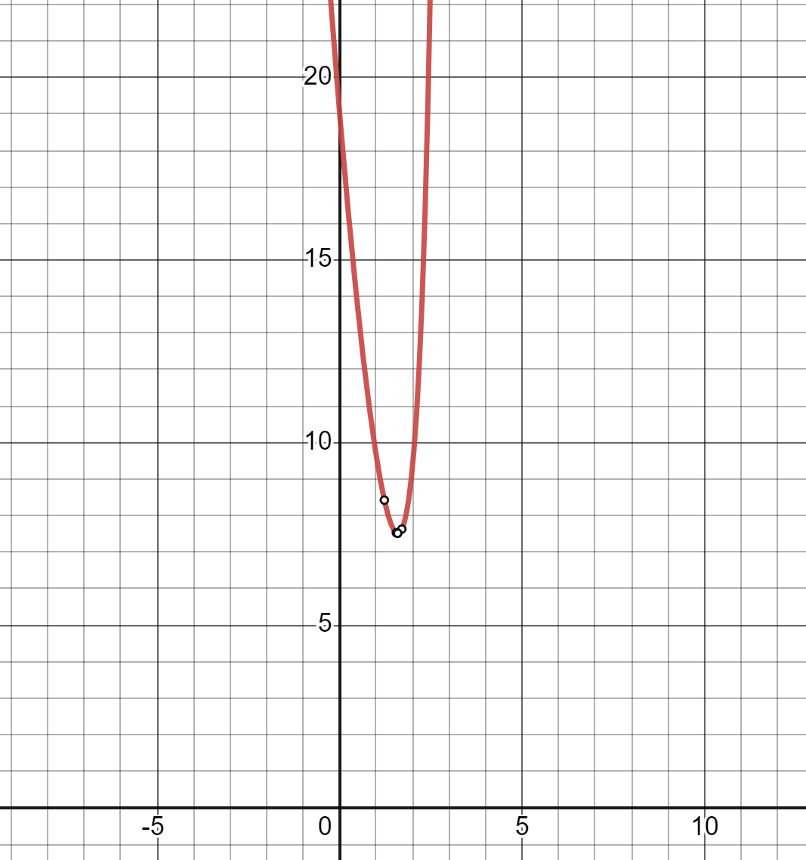
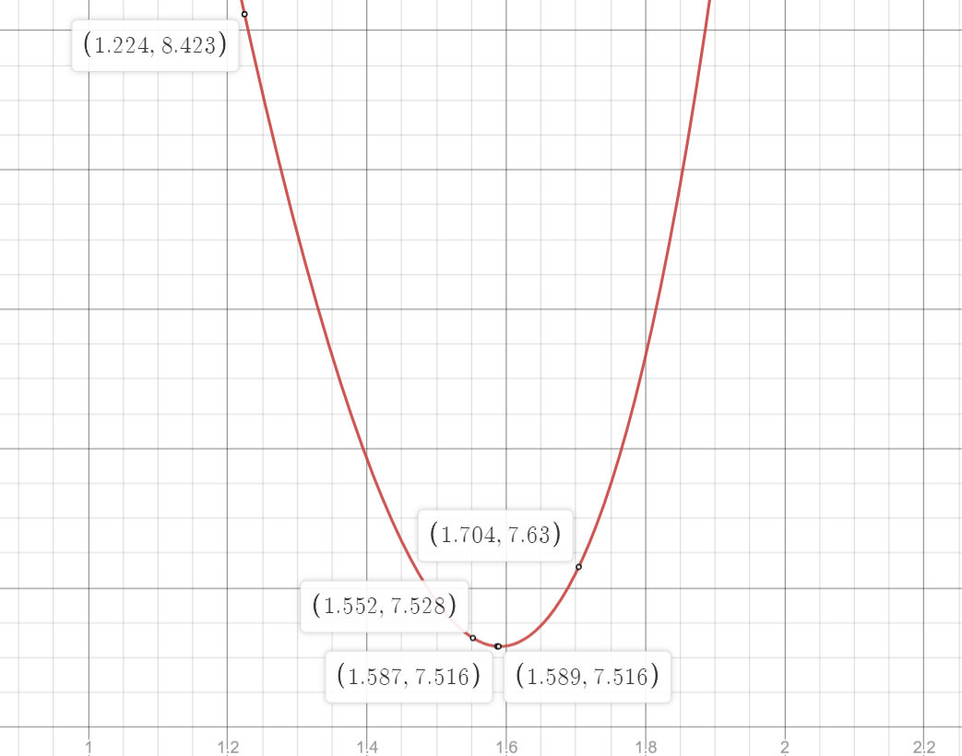

Slide 14
Initial Interval: (-2,3)
 | Bounding Phase Method |  |  |  | Secant Method
S.no. | Initial guess | delta | Interval | Iters | Epsilon | Max Iters | Min x | Min val | Iters
1 | -1.25 | 0.12 | (0.550,2.470) | 5 | 0.001 | 100 | 1.5906 | 7.515924 | 9
2 | 0.45 | 0.1 | (1.150,1.950) | 4 | 0.0001 | 100 | 1.590697 | 7.515924 | 7
3 | 0.11 | 0.05 | (0.860,1.660) | 5 | 0.0005 | 100 | 1.590697 | 7.515924 | 6
4 | 2.14 | 0.01 | (1.51,1.83) | 6 | 0.0002 | 100 | 1.590714 | 7.515924 | 5
5 | 1.00 | 0.02 | (1,30,1.62) | 5 | 0.002 | 100 | 1.590716 | 7.515924 | 4
6 | 2.00 | 0.15 | (1.55,1.85) | 2 | 0.0004 | 100 | 1.590714 | 7.515924 | 5
7 | -1.5 | 0.001 | (0.547,2.595) | 12 | 0.00001 | 100 | 1.590585 | 7.515924 | 11
8 | -0.15 | 0.09 | (1.20,2.64) | 5 | 0.00005 | 100 | 1.590652 | 7.515924 | 8
9 | 0 | 0.005 | (1.275,2.555) | 9 | 0.0006 | 100 | 1.590667 | 7.515924 | 7
10 | -1.95 | 0.008 | (0.09,2.138) | 9 | 0.0004 | 100 | 1.590585 | 7.515924 | 9

Slide 15

Bounding phase method Iterations
Secant Method Iterations, Epsilon = 0.001
Iter | Delta | x0 | x1 | f(x0) | f(x1) | a | b
1 | -0.1000 | 1.657 | 1.557 | -9.057 | -9.446 | 1.557 | 1.657
2 | -0.1000 | 1.557 | 1.357 | -9.261 | -9.888 | 1.357 | 1.557
3 | -0.1000 | 1.357 | 0.957 | -9.612 | -10.263 | 0.957 | 1.357
4 | -0.1000 | 0.957 | 0.157 | -10.088 | -8.964 | 0.157 | 0.957
Iter | x0 | x1 | z | f_dash(x0) | f_dash(x1)
1 | 0.157 | 0.957 | 0.528 | 0.702 | -0.814
2 | 0.957 | 0.528 | 0.527 | -0.814 | -0.001
3 | 0.528 | 0.527 | 0.527 | -0.001 | 0.000

Slide 16
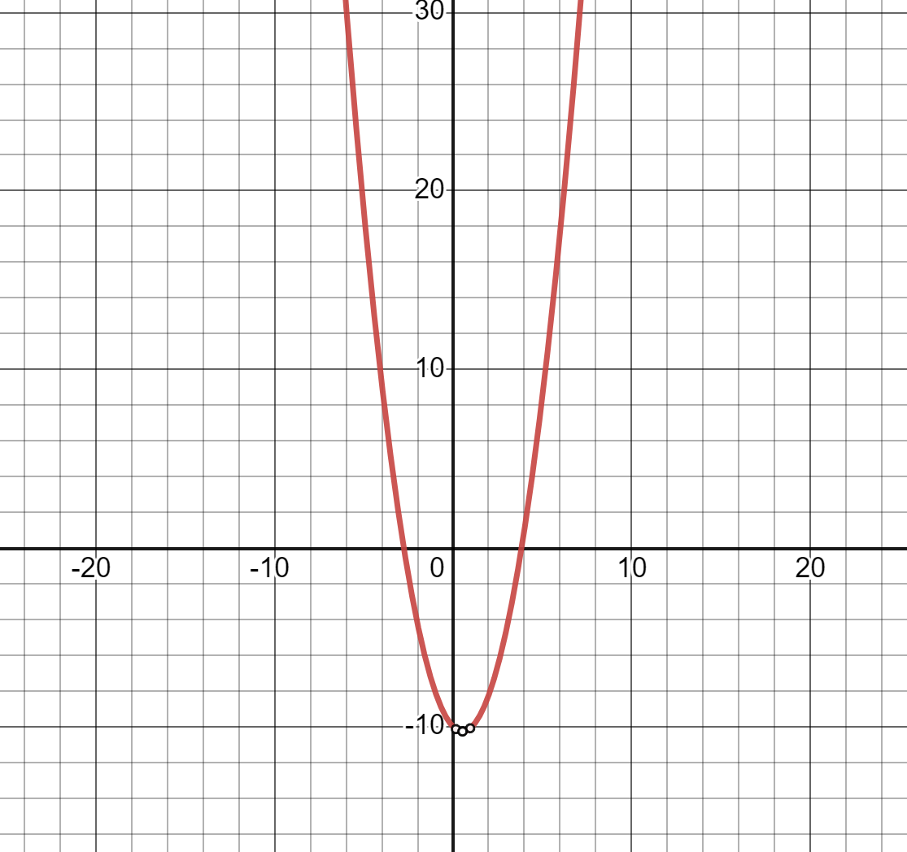
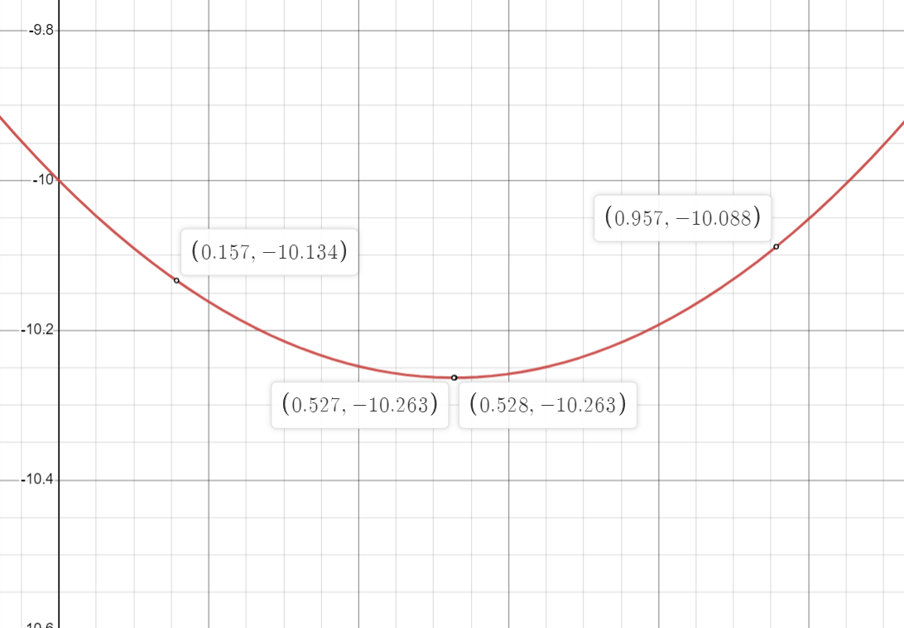

Slide 17
Initial Interval: (-6,6)
 | Bounding Phase Method |  |  |  | Secant Method
S.no. | Initial guess | delta | Interval | Iters | Epsilon | Max Iters | Min x | Min val | Iters
1 | 1.254 | 0.12 | (0.414,0.894) | 3 | 0.001 | 100 | 0.52706 | -10.263405 | 3
2 | 2.45 | 0.1 | (-0.650,0.950) | 5 | 0.0001 | 100 | 0.527060 | -10.263405 | 4
3 | -1.234 | 0.05 | (0.316,1.916) | 6 | 0.0005 | 100 | 0.527060 | -10.263405 | 4
4 | 2.45 | 0.01 | (-0.100,1.180) | 8 | 0.0002 | 100 | 0.527060 | -10.263405 | 4
5 | 1.784 | 0.02 | (0.524,1.164) | 6 | 0.002 | 100 | 0.527060 | -10.263405 | 6
6 | 3.14 | 0.15 | (-1.51,0.89) | 5 | 0.0004 | 100 | 0.527060 | -10.263405 | 4
7 | 4.5 | 0.001 | (0.4050,2.453) | 12 | 0.00001 | 100 | 0.527060 | -10.263405 | 4
8 | -3.14 | 0.09 | (-0.35,2.53) | 6 | 0.00005 | 100 | 0.527061 | -10.263405 | 4
9 | 1.45 | 0.005 | (0.175,0.815) | 8 | 0.0006 | 100 | 0.527060 | -10.263405 | 3
10 | 1.345 | 0.008 | (0.329,0.841) | 7 | 0.0004 | 100 | 0.527060 | -10.263405 | 3

Slide 18

Bounding phase Iterations
Secant method Iterations, Epsilon = 0.001
Iter | Delta | x0 | x1 | f(x0) | f(x1) | a | b
1 | 0.1200 | -0.265 | -0.145 | -6.292 | -3.205 | -0.265 | -0.145
2 | 0.1200 | -0.145 | 0.095 | -3.205 | 1.762 | -0.145 | 0.095
3 | 0.1200 | 0.095 | 0.575 | 1.762 | 5.917 | 0.095 | 0.575
Iter | x0 | x1 | z | f_dash(x0) | f_dash(x1)
1 | 0.095 | 0.575 | 0.562 | -17.060 | 0.466
2 | 0.575 | 0.562 | 0.564 | 0.466 | -0.054
3 | 0.562 | 0.564 | 0.564 | -0.054 | -0.000
4 | 0.564 | 0.564 | 0.564 | -0.000 | 0.000

Slide 19
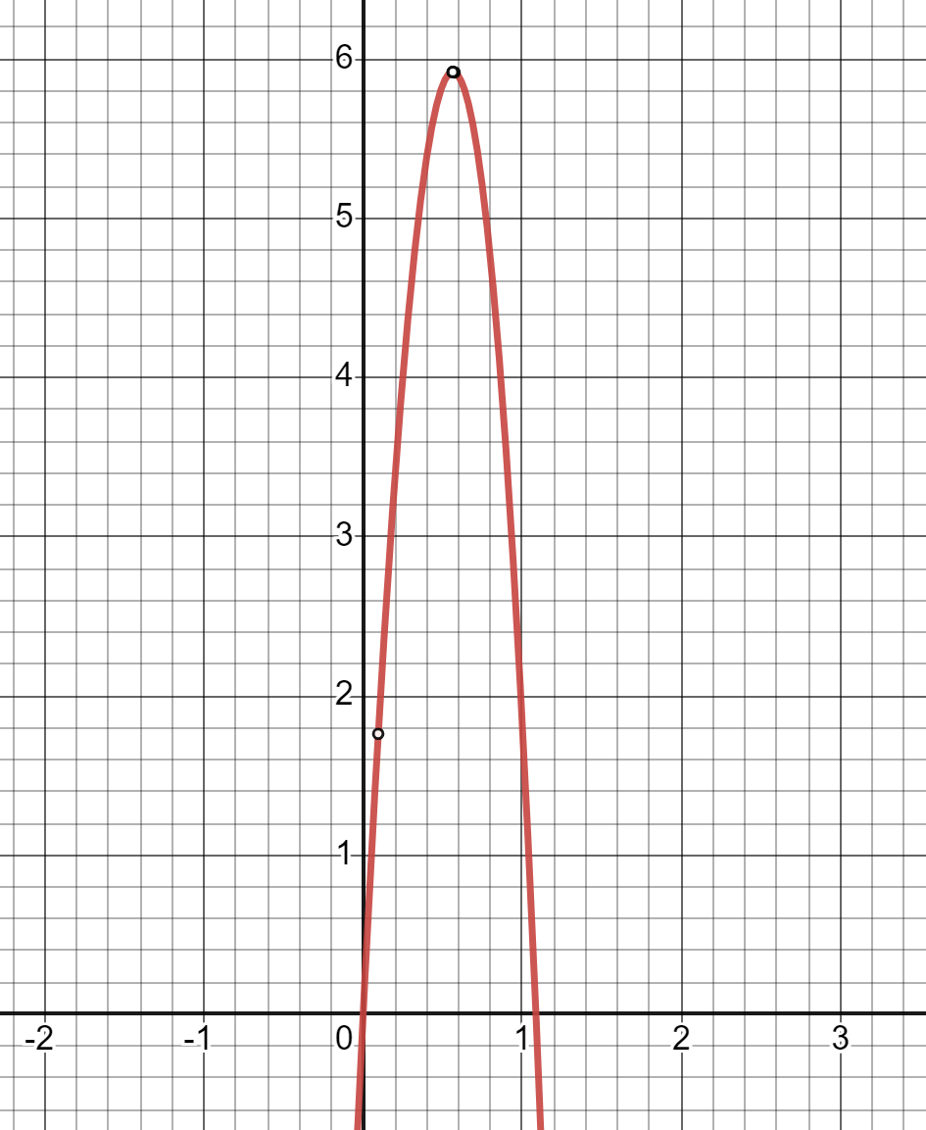
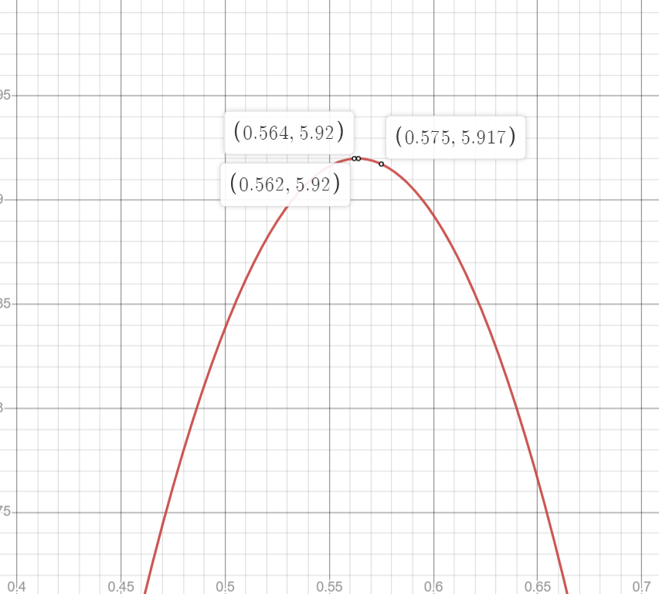

Slide 20
Initial Interval: (-4,4)
 | Bounding Phase Method |  |  |  | Secant Method
S.no. | Initial guess | delta | Interval | Iters | Epsilon | Max Iters | Max x | Max val | Iters
1 | -0.265 | 0.12 | (0.095,0.575) | 3 | 0.001 | 100 | 0.563568 | 5.91998 | 4
2 | -1.254 | 0.1 | (0.246,1.846) | 5 | 0.0001 | 100 | 0.563551 | 5.919983 | 5
3 | 1.001 | 0.05 | (0.251,0.651) | 4 | 0.0005 | 100 | 0.563568 | 5.919983 | 4
4 | 0.894 | 0.01 | (0.264,0.584) | 6 | 0.0002 | 100 | 0.563568 | 5.919983 | 4
5 | -1.54 | 0.02 | (-0.280,1.00) | 7 | 0.002 | 100 | 0.563558 | 5.919983 | 5
6 | 0.184 | 0.15 | (0.334,0.634) | 2 | 0.0004 | 100 | 0.563569 | 5.919983 | 4
7 | 2.148 | 0.001 | (0.101,1.125) | 11 | 0.00001 | 100 | 0.563562 | 5.919983 | 6
8 | 0.16 | 0.09 | (0.430,0.790) | 3 | 0.00005 | 100 | 0.563568 | 5.919983 | 5
9 | 3.1 | 0.005 | (-0.9955,1.0525) | 13 | 0.0006 | 100 | 0.563540 | 5.919983 | 6
10 | -1.97 | 0.008 | (0.070,2.118) | 9 | 0.0004 | 100 | 0.563539 | 5.919983 | 5

Slide 21
CONCLUSION
Bounding phase method and Secant method were used to optimize six different functions and they were executed successfully without any error.
By using the bounding phase method as bracketing method, the initial interval given for optimization were narrowed.
Smaller the value of delta, smaller is the final interval after bracketing. Also for the same initial value, smaller the value of delta, higher is the number of iterations.
Using the secant method for optimization, we can get the accurate maximum or minimum value within few iterations.
Higher the accuracy required (lower epsilon value), higher are the number of iterations.
If the optimum value has more number of decimal digits, higher are the iterations to reach it accurately.

Slide 22
THANK YOU

